Slide 1

Università degli studi di Roma ‘Tor Vergata’
MACROAREA DI INGEGNERIA
Master’s degree thesis in ICT & Internet Engineering
”Analysis of drone’s micro-Doppler signature with FMCW radars”
Candidato:
Relatore:
Ivan Riolo
Prof. Mauro Leonardi
ANNO ACCADEMICO 2020/2021

Slide 2
Outline
Introduction and Common solutions;
Proposed solution: FMCW radar for micro-Doppler analysis;
Received signal model and Waveform design;
Results and performances;
Conclusions and Future works;

Slide 3
Introduction and Common Solutions

Slide 4
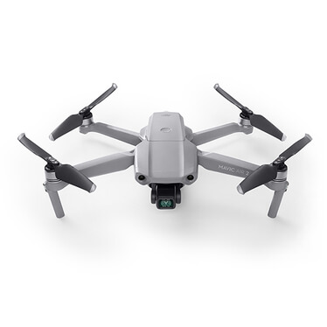

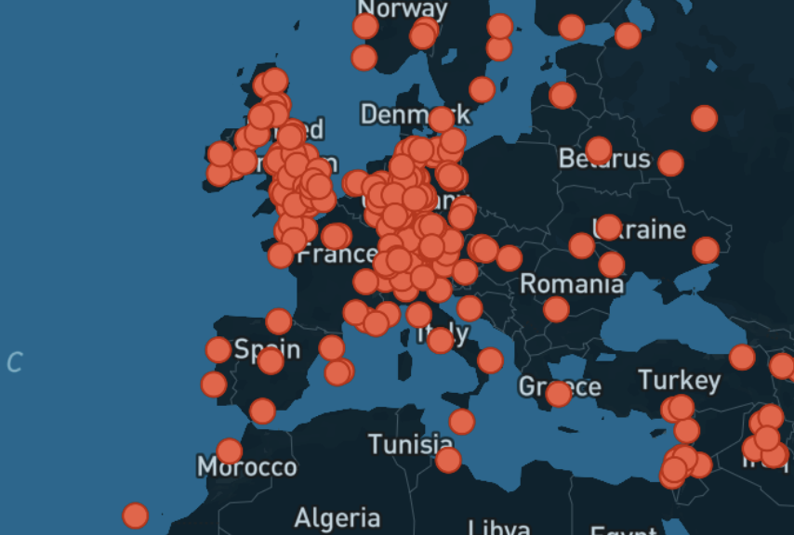

Drone Detection and Identification
Commercial mass-market drones available at low cost and easy to use;
Unbalance between drone capability and availability Vs security and control;
Growth of incidents due to unauthorized drones in last months;
Civil context as private areas, i.e. houses or boats, public areas, crowded squares, public events
Drone monitoring tools requirements: low cost, portable and scalable;
Worldwide Drone Incidents map [1]
$$1/13$$

Slide 5

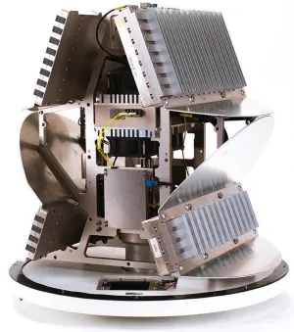

Currently Available Solutions
The most complete solution
Devices | Measurement | Drowbacks
Optic/IR cameras | Heat | Privacy, Range
RF scanner | RF messages | Autonomous flight
Acoustic sensors | Noise | Noisy environment
Radar | EM signals | Identification
Radar technology
Longer range, Auto pilot, No privacy issues
Hybrid is the most complete system
Also single radar system can be complete
IRIS Robin Radar
$$2/13$$

Slide 6
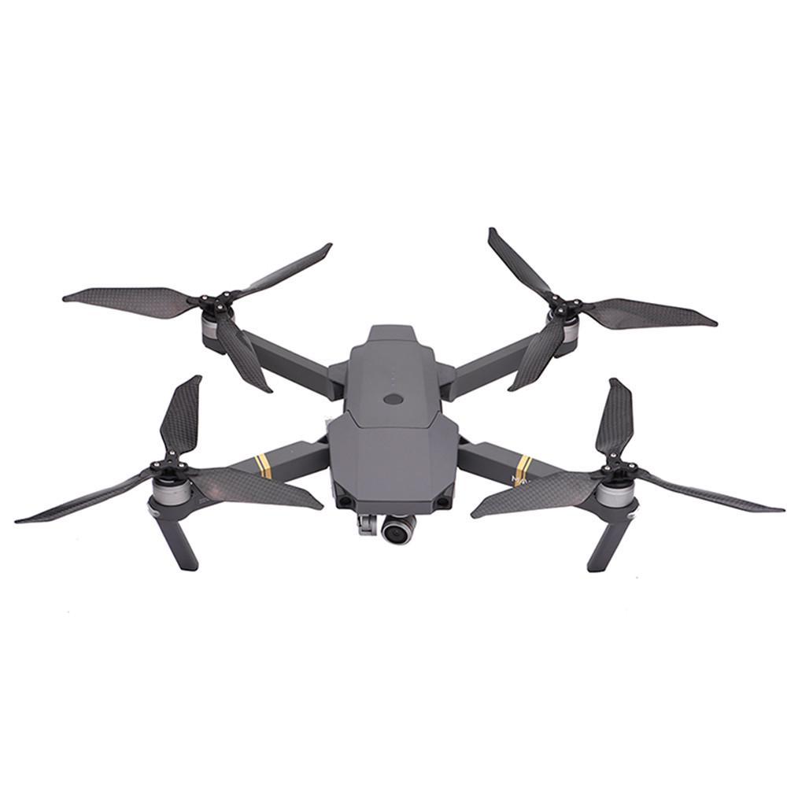
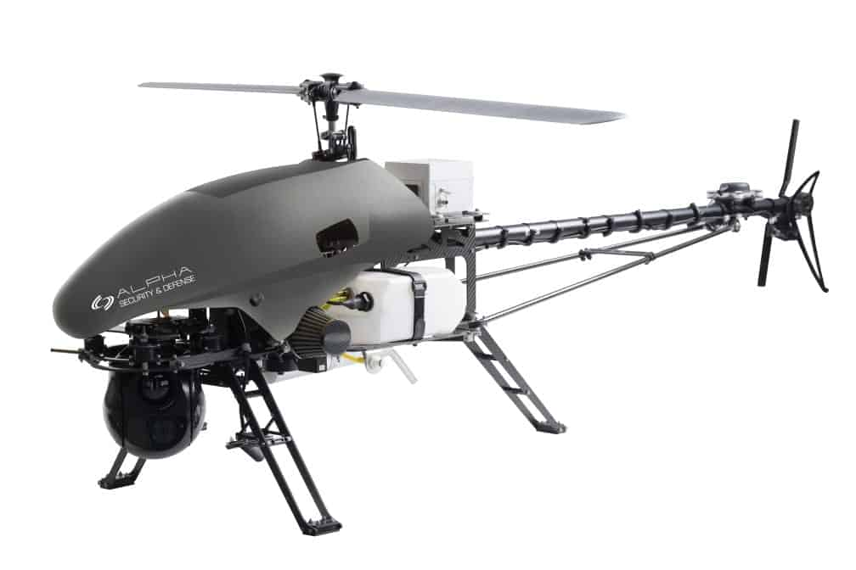
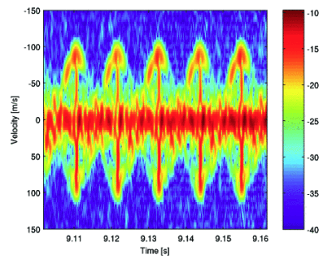
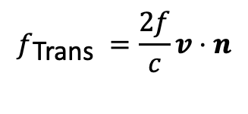





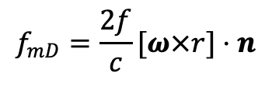
Radar Solutions
How a radar can distinguish a drone from other targets/birds?
Micro-Doppler
Helicopter Drone
Quadcopter Drone
Rotating or vibrating part add a further frequency shift to the usual Doppler frequency
We have two Doppler terms, the classical one due to the radial velocity and the one due to the rotational part:
$$f_{max}$$
$$f_{\text{Trans} }=\frac{2f}{c}v⋅n$$
$$f_{mD}=\frac{2f}{c}[ω×r]⋅n$$
With Short Time Fourier Transform analysis the Spectrogram is obtained and $f_{mD}$ can be measured
$$T_{BF}$$
Only under specific conditions
$$T_{dwell}$$
$$3/13$$

Slide 7
Proposed solution: FMCW radar for micro-Doppler analysis

Slide 8
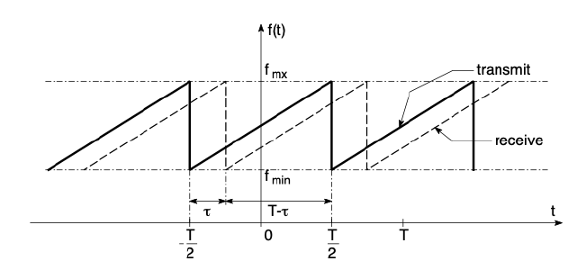
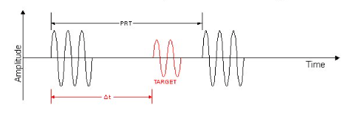
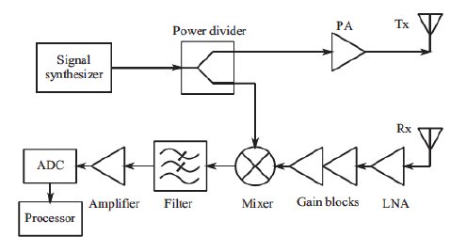

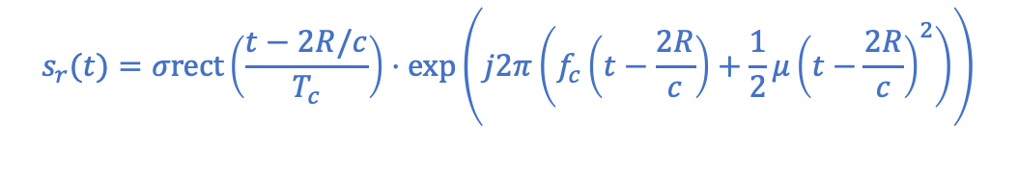

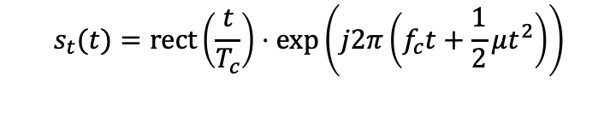




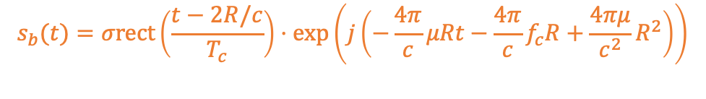
Radar Solutions
Pulsed radar
FMCW radar
Pulsed radar, CW and FMCW radars
Why FMCW is more suitable for our case? Simpler processing, lower energy and cost
FMCW block diagram and Tx/Rx signals
$$s_{t}(t)$$
$$s_{t}(t)=rect\left(\frac{t}{T_{c}}\right)⋅exp\left(j2π\left(f_{c}t+\frac{1}{2}μt^{2}\right)\right)$$
$$s_{r}(t)=σrect\left(\frac{t−2R/c}{T_{c}}\right)⋅exp\left(j2π\left(f_{c}\left(t−\frac{2R}{c}\right)+\frac{1}{2}μ{\left(t−\frac{2R}{c}\right)}^{2}\right)\right)$$
$$s_{b}(t)$$
$$s_{t}(t)$$
$$s_{b}(t)=σrect\left(\frac{t−2R/c}{T_{c}}\right)⋅exp\left(j\left(−\frac{4π}{c}μRt−\frac{4π}{c}f_{c}R+\frac{4πμ}{c^{2}}R^{2}\right)\right)$$
$$s_{r}(t)$$
Cell Migration Effect
$$4/13$$

Slide 9

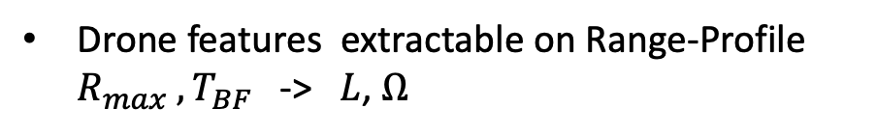
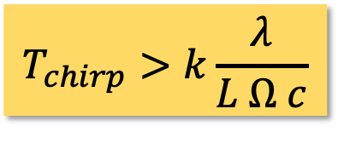
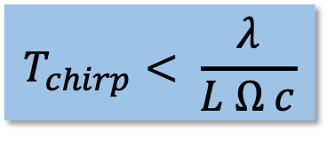
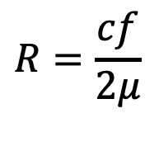

Proposed Solutions
Target
The spectrogram is the only way to extract mD informations?
Range Profile
A problem can be exploited as a benefit:
$$R=\frac{cf}{2μ}$$
Cell migration
No Cell migration
With choice of chirp duration
Time
Time
$$T_{chirp}>k\frac{λ}{L Ω c}$$
$$T_{chirp}< \frac{λ}{L Ω c}$$
To emphasize migration
To avoid migration
Range-cell
Range-cell
Drone features extractable on Range-Profile $R_{max} ,T_{BF}$ -> $L$, $Ω$
We need a drone math model to verify the best solution
Range profile
Spectrogram
$$5/13$$

Slide 10
Received signal model and Waveform design

Slide 11
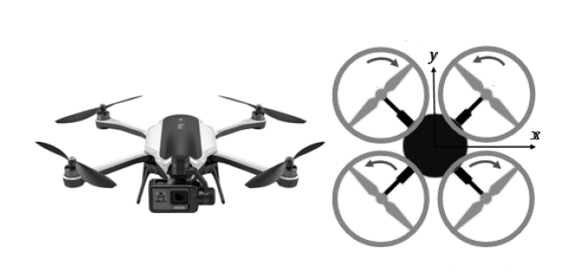
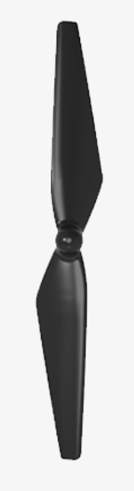

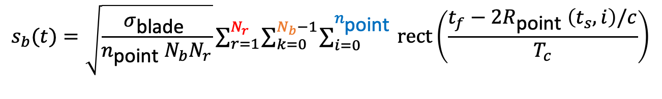





Received Signal Model
$$N_{b}=2$$
What is the signal model adopted?
$$γ$$
The Scattering Center model is adopted
$$s_{b}(t)=\sqrt{\frac{σ_{\text{blade} }}{n_{\text{point} }N_{b}N_{r}}}∑_{r=1}^{N_{r}} ∑_{k=0}^{N_{b}−1} ∑_{i=0}^{n_{\text{point} }} rect\left(\frac{t_{f}−2R_{\text{point} }\left(t_{s},i\right)/c}{T_{c}}\right)$$
$$N_{r}=4$$
$$⋅exp\left(j\left(−\frac{4π}{c}μt_{f}R_{\text{point} }\left(t_{s},i\right)−\frac{4π}{c}f_{c}R_{\text{point} }\left(t_{s},i\right)+\frac{4πμ}{c^{2}}R_{\text{point} }{\left(t_{s},i\right)}^{2}\right)\right)$$
$$dρ$$
By setting $N_{b}$, $N_{r}, γ e Ω$ a specific drone model is defined
$$n_{point}$$
It’s possible to simulate the radar processing and to evaluate the detection perfomances
$$6/13$$

Slide 12
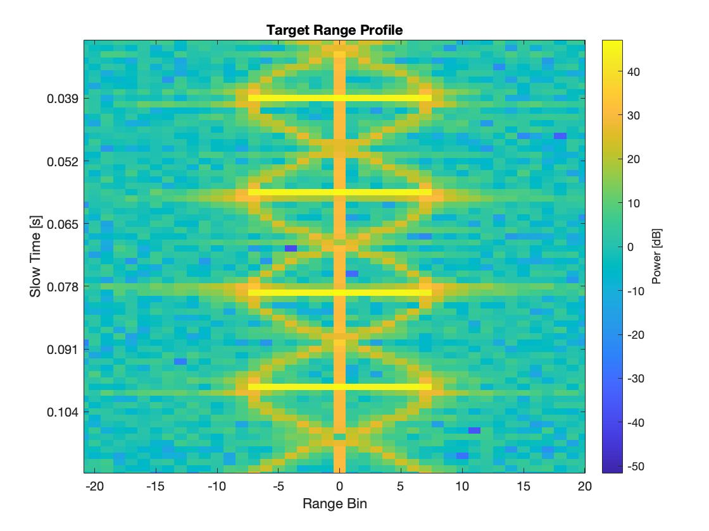
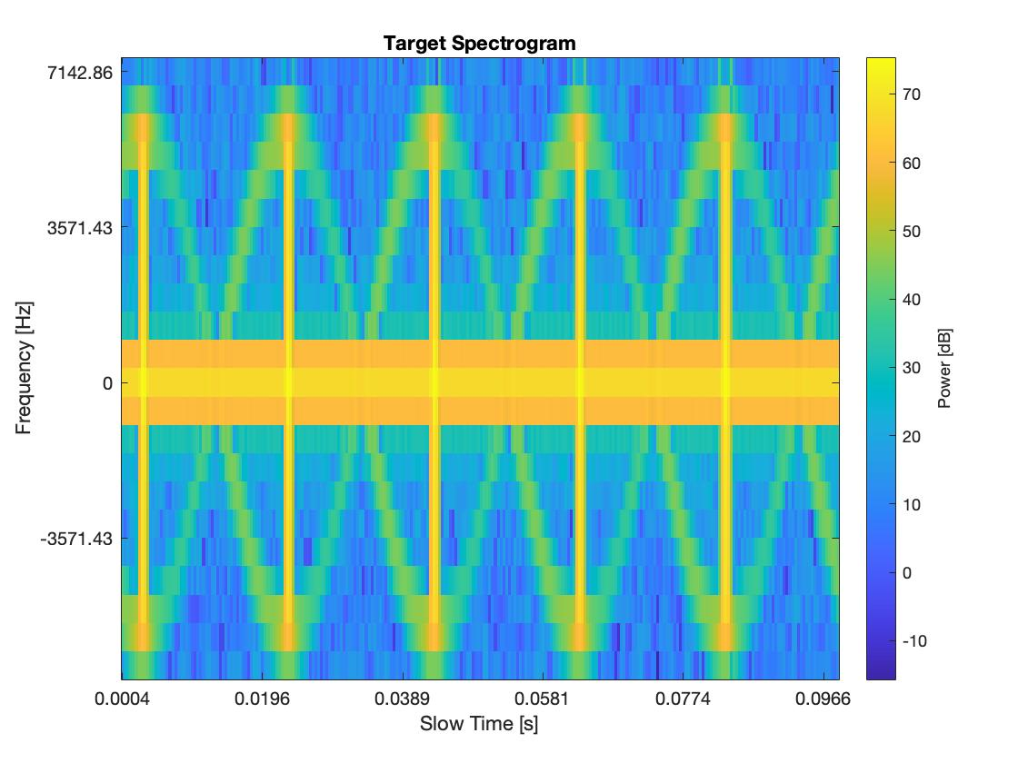



Received Signal Model
R
2DFFT signal processing
Received signal is sampled and arranged in a 2D Matrix
$$T_{BF }$$
Range Profile Analysis
1 FFT cycle done
in parallel
$R_{max }$
Range Profile Analysis
t
Faster and cheaper
R
Spectrogram Analysis
2 FFT cycle done
with STFT algo.
Range Profile Analysis
Slower and expensive
t
How can we reach this resolution?
$$7/13$$

Slide 13
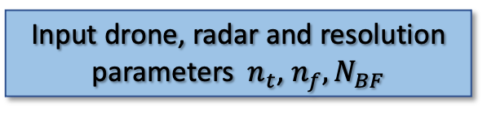
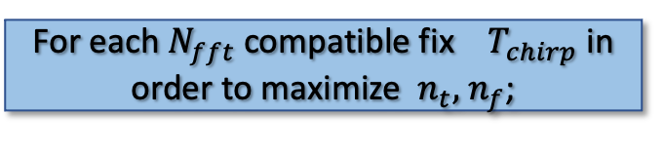
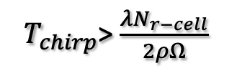

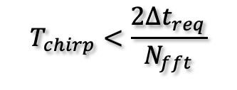

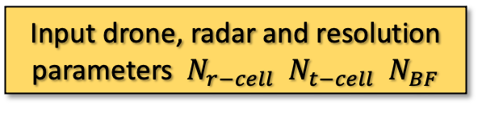

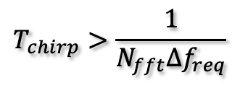
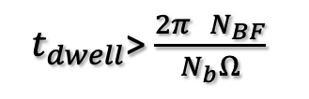

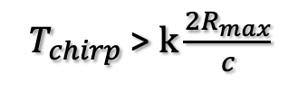
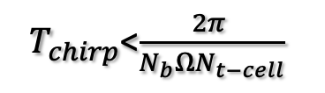
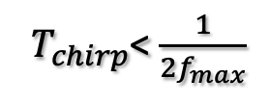
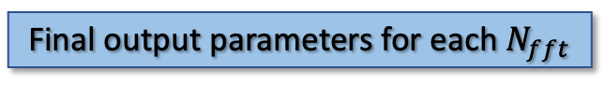
Waveform design algorithms
How to best choice the waveform parameters?
Range-profile analysis
Spectrogram analysis
Input drone, radar and resolution parameters ${ N}_{r−cell}$ ${ N}_{t−cell}$ ${ N}_{BF}$
Input drone, radar and resolution parameters ${ n}_{t}$, $n_{f},N_{BF}$
Most
stringent
${ T}_{chirp}$> $\frac{λN_{r−cell}}{2ρΩ}$
${ T}_{chirp}$<$\frac{2π }{N_{b}ΩN_{t−cell}}$
${ t}_{dwell}$> $\frac{2π{ N}_{BF}}{N_{b}Ω}$
${ T}_{chirp}$ > $k\frac{2R_{max}}{c}$
${ T}_{chirp}$< $\frac{1}{2f_{max}}$
$$T_{chirp}>\frac{1}{N_{fft}{Δf}_{req}}$$
$$T_{chirp}<\frac{2{Δt}_{req}}{N_{fft}}$$
${ T}_{chirp}$ fixed in order to maximize${ N}_{r−cell},{ N}_{t−cell}$
For each $N_{fft}$ compatible fix $T_{chirp}$ in order to maximize ${ n}_{t},$ $n_{f}$;
Final output parameters
Final output parameters for each $N_{fft}$
${{ T}_{chirp}, θ}_{az}$, $d, { P}_{tx}, { f}_{ADC}$
${ T}_{chirp},Δf,Δt, { P}_{tx}, { f}_{ADC}$, $θ_{az}$, $d$
$$8/13$$

Slide 14

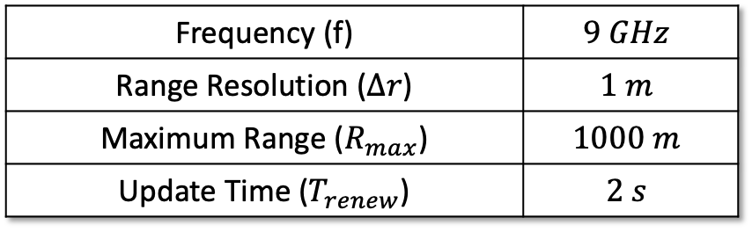


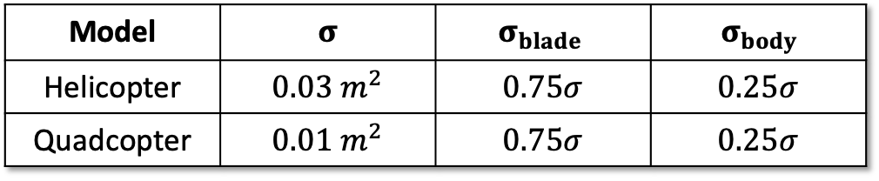
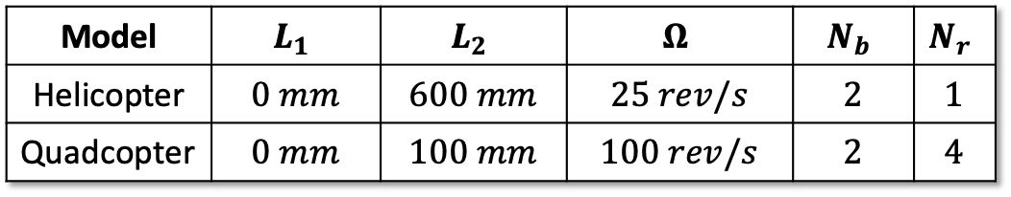

Waveform design algorithms
Input radar, drone’s and desired resolution parameters
Radar parameters:
Generic Helicopter and Quadcopter drone′s parameters:
Frequency (f) | $$9 GHz$$
Range Resolution ($∆r$) | $$1 m$$
Maximum Range ($R_{max}$) | $$1000 m$$
Update Time ($T_{renew}$) | $$2 s$$
Model | $$L_{1}$$ | $$L_{2}$$ | $$Ω$$ | $$N_{b}$$ | $$N_{r}$$
Helicopter | $$0 mm$$ | $$600 mm$$ | $$25 rev/s$$ | $$2$$ | $$1$$
Quadcopter | $$0 mm$$ | $$100 mm$$ | $$100 rev/s$$ | $$2$$ | $$4$$
Desired resolutions:
RCS drone′s parameters:
${ N}_{t−cell}$= $n_{t}$= 5
Model | $$σ$$ | $$σ_{blade }$$ | $${ σ}_{body }$$
Helicopter | $$0.03 m^{2}$$ | $$0.75σ$$ | $$0.25σ$$
Quadcopter | $$0.01 m^{2}$$ | $$0.75σ$$ | $$0.25σ$$
$N_{BF}=5$
${ N}_{r−cell}$= $n_{f}$= 5
$$9/13$$

Slide 15
Results and performances

Slide 16
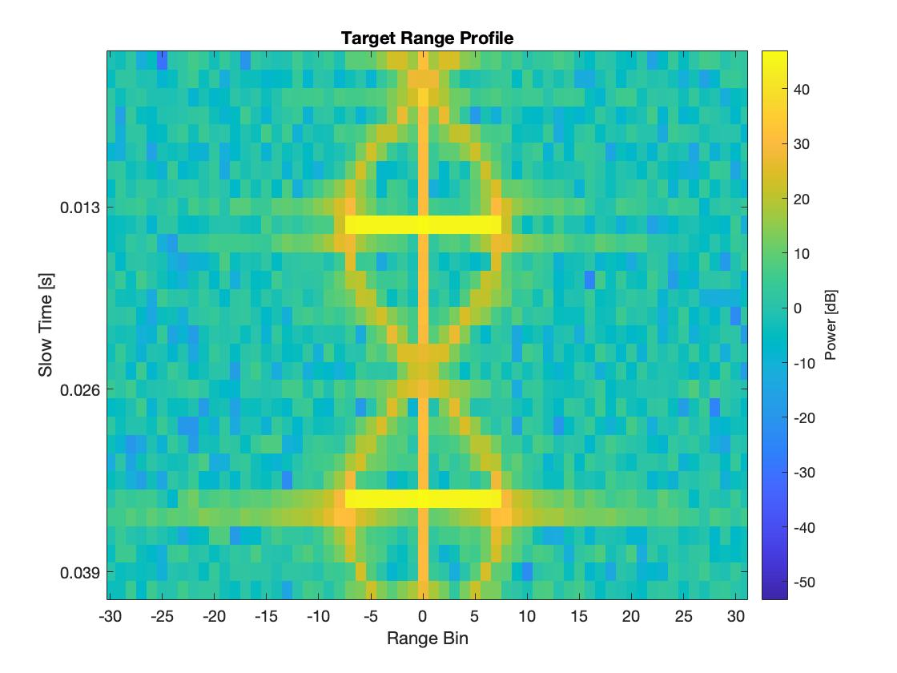
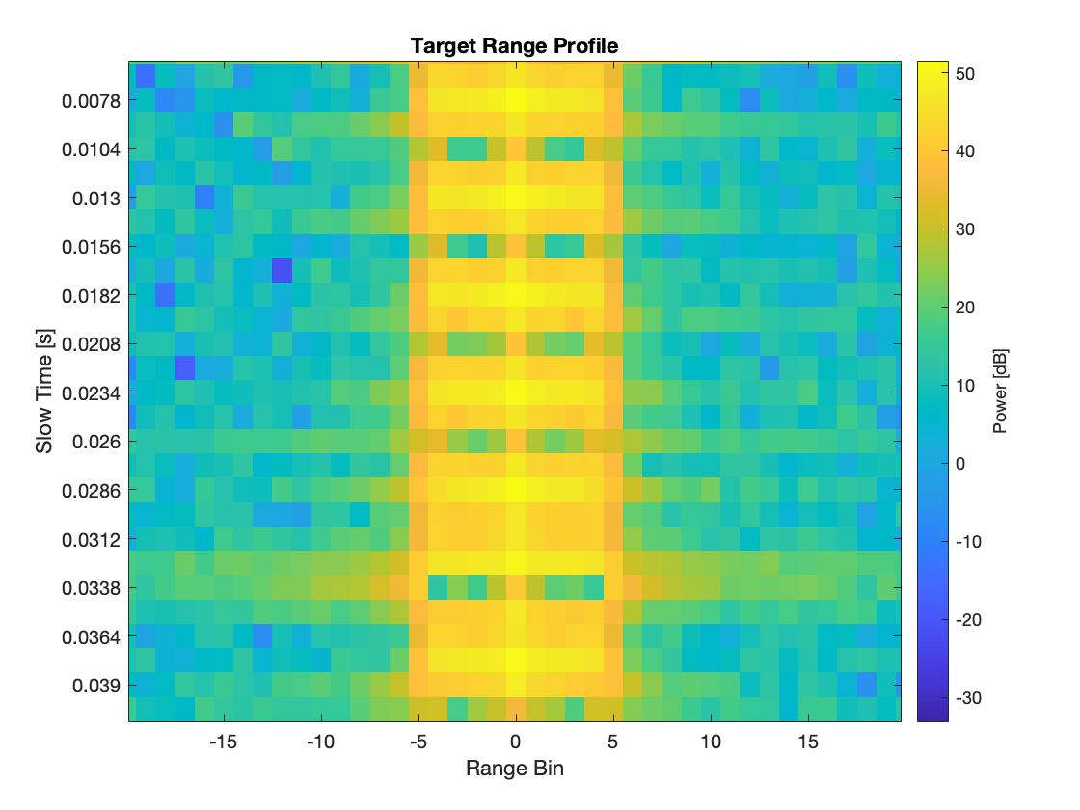

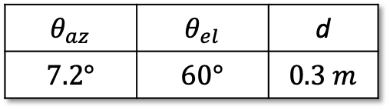

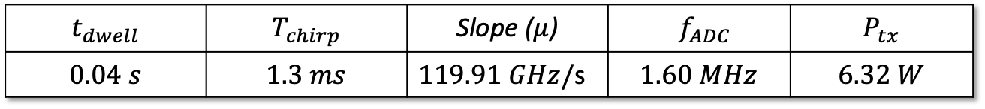



Unique waveform for Range-Time analysis
Waveform Design Output
Antenna parameters
$$t_{dwell}$$ | $$T_{chirp}$$ | Slope ($μ$) | $${ f}_{ADC}$$ | $$P_{tx}$$
$$0.04 s$$ | $$1.3 ms$$ | $119.91 GHz/$s | $$1.60 MHz$$ | $$6.32 W$$
$$θ_{az}$$ | $$θ_{el}$$ | d
$$7.2°$$ | $$60°$$ | $$0.3 m$$
Quadcopter Range Profile
$$N_{t−cell }$$
$$N_{t−cell }$$
$N_{r−cell }$
Helicopter Range Profile
$N_{r−cell }$
$$10/13$$

Slide 17
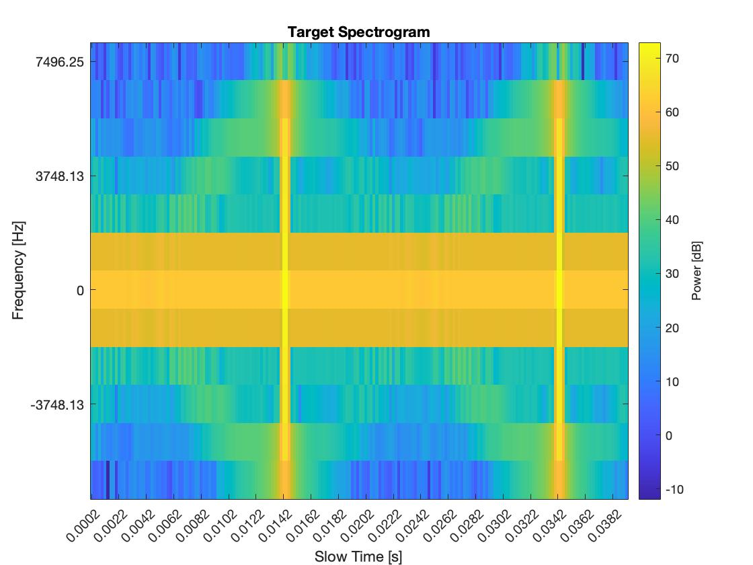
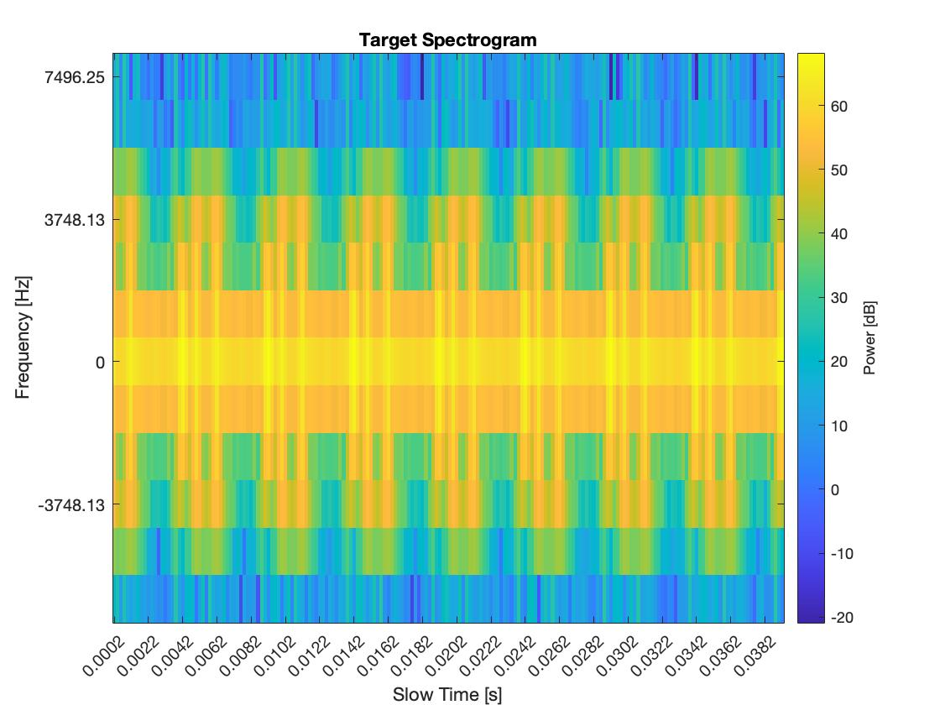



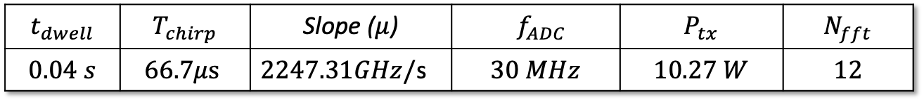



Unique Waveform for Frequency-Time Analysis
Waveform Design Output
Antenna parameters
$$t_{dwell}$$ | $$T_{chirp}$$ | Slope ($μ$) | $${ f}_{ADC}$$ | $$P_{tx}$$ | $$N_{fft}$$
$$0.04 s$$ | $$66.7μs$$ | $2247.31GHz/$s | $$30 MHz$$ | $$10.27 W$$ | $$12$$
$$θ_{az}$$ | $$θ_{el}$$ | d
$$7.2°$$ | $$60°$$ | $$0.3 m$$
Quadcopter Spectrogram
$$n_{f }$$
$$n_{f }$$
$n_{t }$
$n_{t }$
Helicopter Spectrogram
$$11/13$$

Slide 18
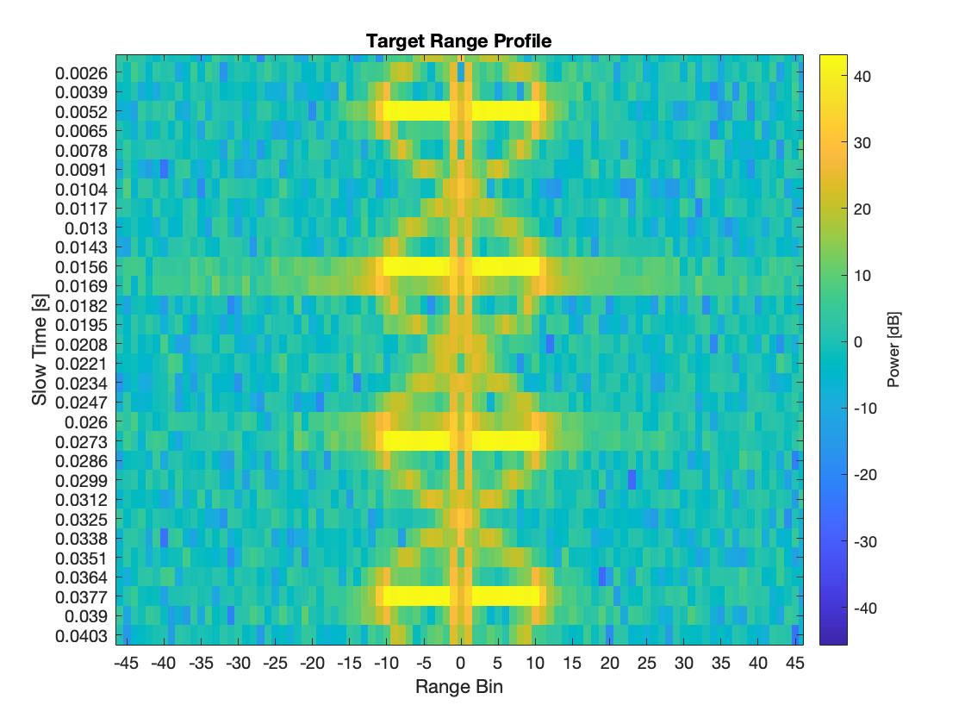
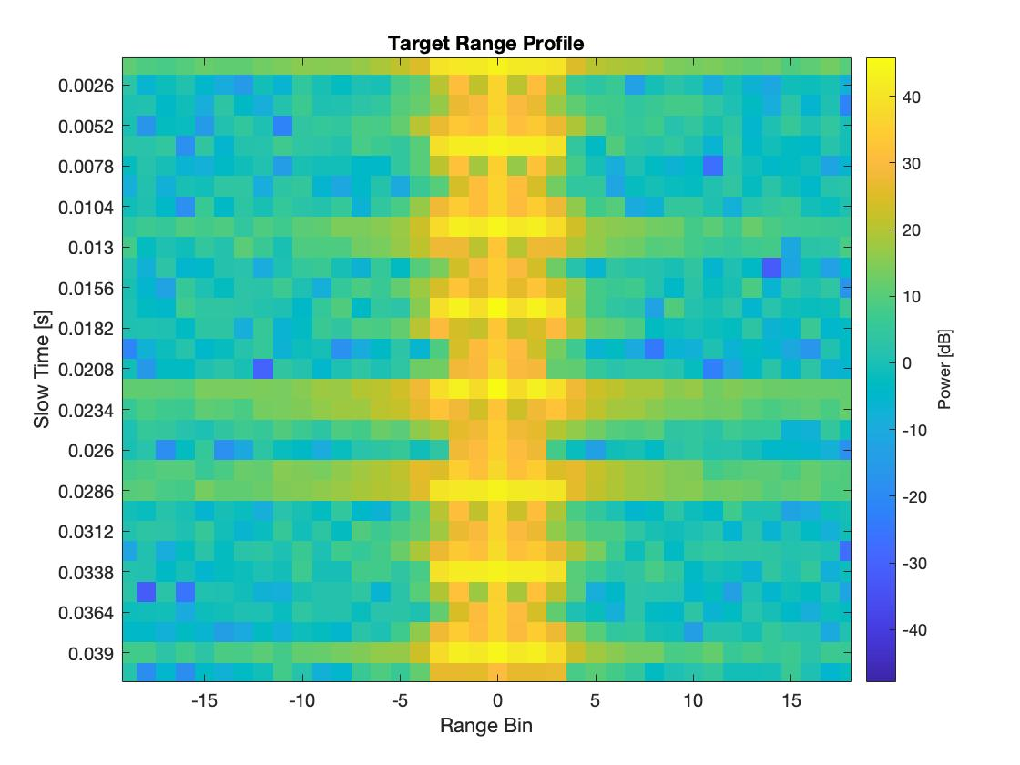
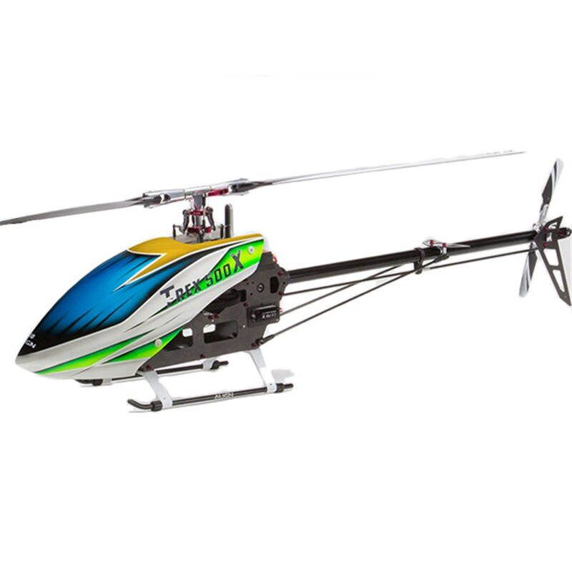
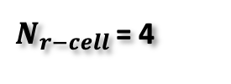










Result for the Range Time Analysis
$$T−Rex 500$$
$$DJI Mavic Air 2$$
$N_{t−cell }$= 8
$N_{t−cell }$= 4
$N_{r−cell }$= 10
$N_{r−cell }$= 4
$4 m/s$ error on $v_{tip}$
$3 mm$ error on blade length
$1.6 m/s$ error $v_{tip}$
$7 mm$error on blade length
$$12/13$$

Slide 19

Conclusion and Future Works
What goals have been achieved?
The range profile analysis offers almost the same precision of spectrogram with:
Lower cost,
Sampling frequency and frequency slope 20 times lower,
Almost half transmitted power,
What could be future works?
Compare Range-Profile analysis with others low cost techniques that also works in Doppler ambiguity (HERM spectral analysis)
Lower processing time,
A math model compatible with those established in the literature to describe micro-Doppler effect;
Trials on field with radar prototype
In any cases it is possible to distinguish drones from objects without rotating parts.
$$13/13$$

Slide 20
Thanks for the Attention!

Slide 21
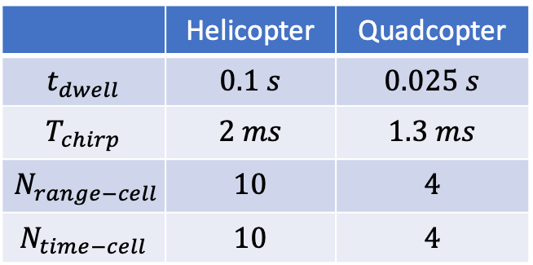
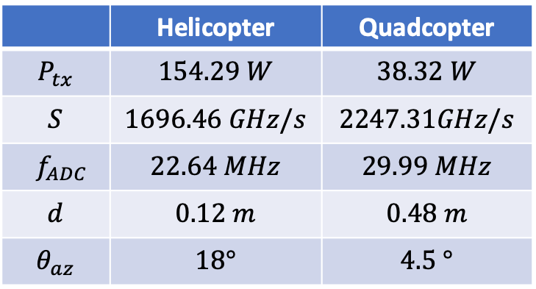


Waveform design algorithms
Due blocchi
Result obtained for the generic Helicopter and Quadcopter drones
Range-profile analysis
Spectrogram analysis
 | Helicopter | Quadcopter
$$t_{dwell}$$ | $$0.1 s$$ | $$0.025 s$$
$$T_{chirp}$$ | $$88.35 ms$$ | $$66.7 ms$$
$$N_{fft}$$ | 12 | 12
$$Δf$$ | $943.13$ $Hz$ | $$1249.37 Hz$$
$$Δt$$ | $$0.5 ms$$ | $$0.4 ms$$
 | Helicopter | Quadcopter
$$t_{dwell}$$ | $$0.1 s$$ | $$0.025 s$$
$$T_{chirp}$$ | $$2 ms$$ | $$1.3 ms$$
$$N_{range−cell}$$ | $$10$$ | $$4$$
$$N_{time−cell}$$ | $$10$$ | $$4$$
Resulting radar parameter:
Resulting radar parameters:
 | Helicopter | Quadcopter
$$P_{tx}$$ | $$81.79 W$$ | $$24 W$$
$$S$$ | $$74.94 GHz/s$$ | $$119.91 GHz/s$$
$${ f}_{ADC}$$ | $$1.01 MHz$$ | $$1.60 MHz$$
$$d$$ | $$0.12 m$$ | $$0.48 m$$
$$θ_{az}$$ | $$18°$$ | $$4.5 °$$
 | Helicopter | Quadcopter
$$P_{tx}$$ | $$154.29 W$$ | $$38.32 W$$
$$S$$ | $$1696.46 GHz/s$$ | $$2247.31GHz/s$$
$${ f}_{ADC}$$ | $$22.64 MHz$$ | $$29.99 MHz$$
$$d$$ | $$0.12 m$$ | $$0.48 m$$
$$θ_{az}$$ | $$18°$$ | $$4.5 °$$

Slide 22







Result for the Range Time Analysis
What happens by applying the unique waveform to real drone models?
Figure dei due droni
Al posto delle tabelle
$$Helic Drone$$ | $$L_{1}$$ | $$L_{2}$$ | $$Ω$$ | $${ N}_{b}$$ | $${ N}_{r}$$ | $${ n}_{p}$$
$$T−Rex 500$$ | $$57 mm$$ | $$470 mm$$ | $$46 rev/s$$ | $$2$$ | $$1$$ | $$36$$
$$Quad Drone$$ | $$L_{1}$$ | $$L_{2}$$ | $$Ω$$ | $${ N}_{b}$$ | $${ N}_{r}$$ | $${ n}_{p}$$ | $${δ }_{max}$$
$$DJI Mavic Air 2$$ | $$5 mm$$ | $$70 mm$$ | $$91.6 rev/s$$ | $$2$$ | $$4$$ | $$6$$ | 125mm
Features extracted from the Range Profile:
Drone parameters relations:
$$N_{r−cell }$$
$$N_{t−cell }$$
$$R_{migr}= \frac{c{ v}_{tip}}{μ λ}$$
$$Ω= \frac{2π}{N_{b}T_{BF}}$$
$$R_{migr}=N_{r−cell }∆r$$
$T_{BF}$ = $N_{t−cell }∆t$
$$v_{tip}=LΩ$$

Slide 23
Actual Solutions
But how it is possible to observe the target’s time-frequency map?
Spectrogram
If we perform a Fourier Transform each limited time interval on the received signal we obtain the time-frequency variations
The choice of a suitable window length is critical for time and frequency resolution, usually Hamming window is used
The typical spectrogram of helicopter drone build with this procedure clearly show the sinusoidal frequency modulation induced by the rotor
Wide window –> Lower time res and Higher freq. res
Narrow window –> Higher time res and Lower freq. res

Slide 24





Proposed Solutions
When does cell migration occur?
Computing the received signal frequency from target, we have two terms, the first contains the range information, the second is the Doppler frequency
By limiting the second term of range variations we obtain the dependancy on chirp duration
Simulating the range variation equation it’s possible to extract the same drone’s features extracted in frequency-time map
To avoid cell migr.
$$T_{chirp}< \frac{λ}{L Ω c}$$
To emphasize cell migr.
$$T_{chirp}>k\frac{λ}{L Ω c}$$

